Slide 1

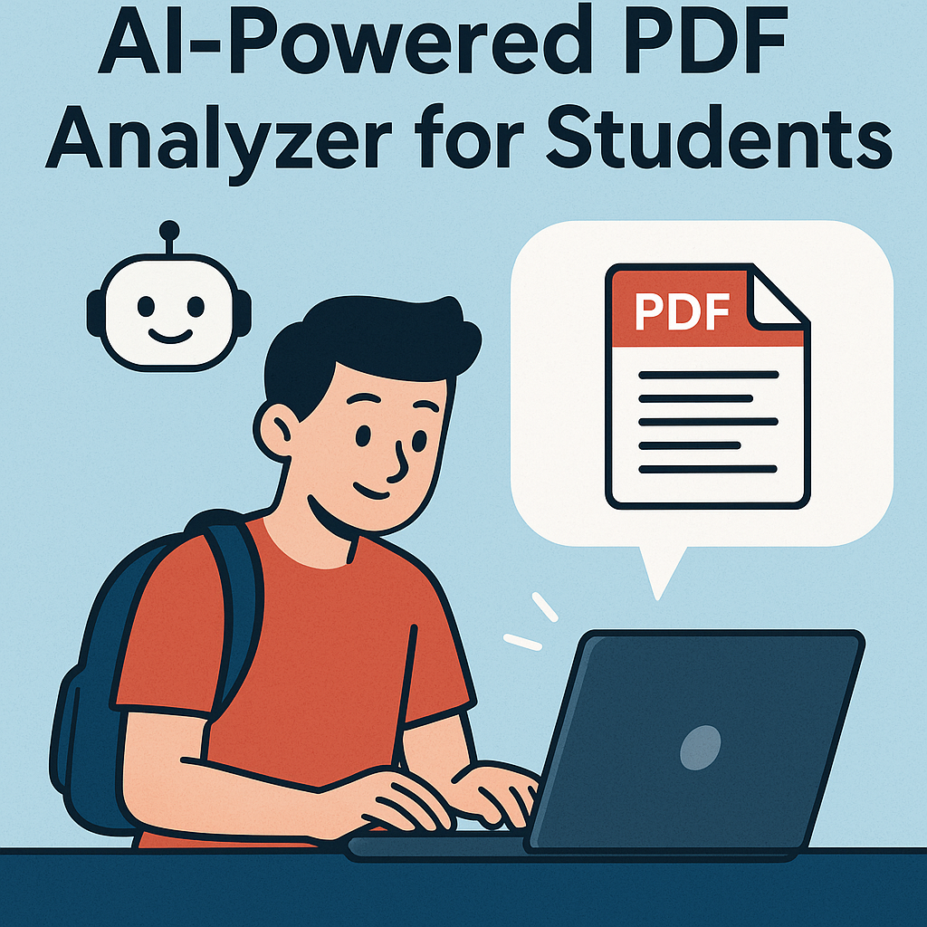
Introduction to StudyMate
The AI powered PDF analyzer for students
TEAM NAME: CDN
TEAM MEMBERS:
B.Chandu
K.S.S.Dinesh
B.Nithin

Slide 2

StudyMate: AI-Powered Q&A System
StudyMate is an innovative AI-driven question-and-answer system designed specifically for students. By leveraging PDF documents, it provides instant answers to student queries, significantly enhancing learning efficiency and accessibility. This cutting-edge tool aims to streamline the study process, making education more engaging and effective.

Slide 3



Introduction to StudyMate
What is StudyMate?
Target Audience
User-Friendly Interface
An AI-powered tool for answering PDF content questions.
Designed for students of all educational levels.
Features a simple and intuitive design for easy navigation.

Slide 4



Core Features
PDF Compatibility
AI-Powered Responses
2
The system supports various PDF formats, allowing students to upload their study materials seamlessly.
StudyMate uses AI algorithms to analyze PDF content and provide relevant answers to user queries in real-time.
1
Instant Feedback
3
Users receive immediate feedback, which promotes active learning and helps clarify doubts without delays.

Slide 5

Modules Used for Study-Mate
Programming Languages: Python
Backend: FastAPI
Frontend: Streamlit
Database: MongoDB
LLM: Hugging Face

Slide 6



Benefits for Students
Enhanced Learning Efficiency
24/7 Availability
Customizable Study Sessions
Students can access StudyMate anytime, making it a flexible study aid that fits various schedules and study habits.
By providing quick answers, StudyMate allows students to spend less time searching for information and more time understanding the material.
Users can tailor their learning experience by focusing on specific topics or questions, enabling personalized study sessions.

Slide 7



Use Cases of StudyMate
Homework Help
Exam Preparation
Research Assistance
Students receive instant assistance on homework questions, improving their understanding of concepts.
StudyMate helps in revision by answering questions from practice papers, ensuring comprehensive exam readiness.
The system aids in finding relevant information from PDF research papers, boosting research skills.

Slide 8


Conclusion
Transforming Study Habits
Empowering Students
Encouraging Lifelong Learning
By providing instant access to information, StudyMate empowers students to take control of their learning journeys.
StudyMate has the potential to revolutionize how students interact with their learning materials, making study processes more efficient and effective.
The system promotes a culture of curiosity and self-directed learning, essential skills for success in the modern educational landscape.

